Slide 1
Brief guide to version control DISP lab
Speaker: 顏子鈞
2023/03/28

Slide 2
outline
What is version control?
Git
Setting up a repository
Basic commands
.gitignore
Branching
Pull Request
Code Review
Some Great Tools
Tips for writing commit message
Reference

Slide 3
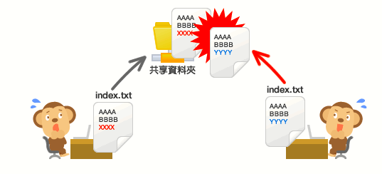
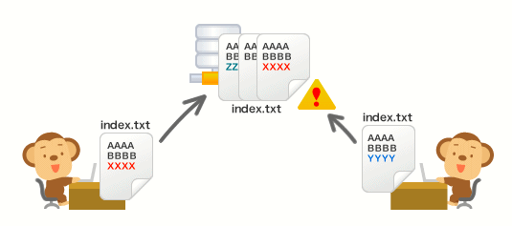
What is version control?
“Version control is the practice of managing changes to code over time. ”
Importance:
Allows teams of developers to collaborate on projects without overwriting each other's work or losing track of changes.
Track every modification made to a file, and easily roll back to a previous version if necessary.
Learning version control is an important skill for anyone who wants to work in software development, as it is widely used in the industry.
Image source: https://backlog.com/git-tutorial/tw/intro/intro1_1.html

Slide 4
git
The most popular open source version control tool.
created by Linus Torvalds in 2005, to manage the development of Linux kernel.
It supports all operating system, and has a lot of extensions for different kinds of developing environment.
Git uses a repository to store all the files and changes made to them, as well as the history of those changes.
Repository: a folder on your computer where Git will track changes to your files.
/MyProject ----/src -----/… many code ----/bin -----/… many file ----/data -----/ … many data ----/Readme.md
Respository name
respository
Source: The New Yorker
Notes:
Built linux at age of 21.

Slide 5
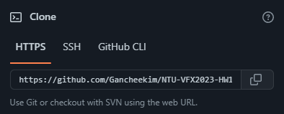
Git – setting up a repository
In 2 ways:
Initializing a Git repository (from scratch)
navigate to the folder
run the command "git init".
Cloning an existing repository
find the repository's URL.
run the command "git clone <url>”
(for first time) customize your Git configuration by setting :
your name
email address

Slide 6
Git – basic commands
git add
git commit
git push
git status
git log
git pull

Slide 7
Git – basic commands
git add
Example: “git add index.html” or “git add *”
Telling Git to track those changes and include them in your next commit.
git commit
git push
git status
git log
git pull

Slide 8
Git – basic commands
git add
git commit
Example:
“git commit –m <commit messages>”
“git commit –a –m <commit messages>” (automatic commit all tracked file, without the need of “git add”)
creating a snapshot of your code at that point in time. You'll also need to include a commit message to describe the changes you've made
git push
git status
git log
git pull
For example:
I already git add 3 files.
I use git commit.
The snapshot records the changes of the 3 files.

Slide 9
Git – basic commands
git add
git commit
git push
example: “git push”
Flags:
“-f” (brute force push, overwriting everything, USE AT YOUR OWN RISK)
“-n” (simulate the push operation, without really pushing anything. Useful for testing)
push your changes to a remote repository (GitHub, Gitea), so that others can see your modifications.
git status
git log
git pull

Slide 10
Git – basic commands
git add
git commit
git push
git status
Usage: “git status”
show you which files have been modified or staged for commit, which files are untracked, and any other relevant information about your repository.
git log
git pull

Slide 11
Git – basic commands
git add
git commit
git push
git status
git log
Example: “git log” (there are many flags, study yourself)
view the commit history of your repository, along with the commit message, author, date, and other relevant information.
git pull

Slide 12
Git – basic commands
git add
git commit
git push
git status
git log
git pull
Example: “git pull” (there are many flags, study yourself)
pull changes from a remote repository to your local repository.
If you are working on something that might conflict with the pull, remember to “git stash” or “git commit” first

Slide 13
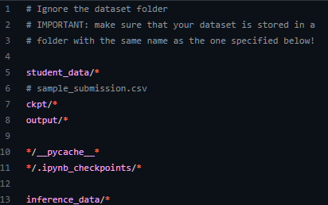
git - .gitignore
.gitignore:
used to specify files or directories that should be ignored by Git when tracking changes in a project.
Very useful, since GitHub restricts any files larger than 50mb, and also avoid slow push/pull everytime.
The “*” indicates everything inside the directory
The “*<pattern>*” indicates every file with the same naming pattern

Slide 14
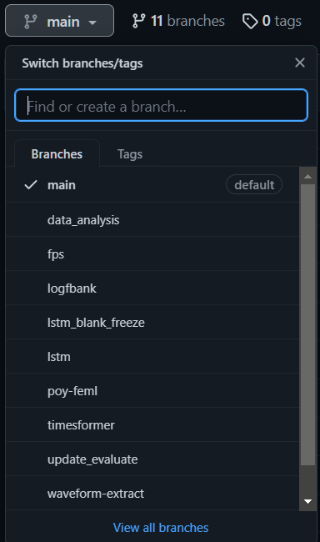
Git - branching
Git branches: independent lines of development that allow you to work on different features or versions of your code in parallel.
By default, Git creates a main branch called "master", but you can create new branches using the "git branch" command. Example: “git branch data_analysis”
To switch to a different branch, you can use the "git checkout" command, followed by the name of the branch. Example: “git checkout data_analysis”
To merge changes from one branch to another: use the "git merge" command. This combines the changes from one branch into another branch, creating a new commit that represents the merged changes.
HOWEVER, the best practice to merge between branches is using Pull Request (which requires Code Review).
Example: DLCV final project’s branches

Slide 15
pull request (PR)
What is PR?
Requesting other developer to review/suggest improvement/catch errors on your working branch.
Then, you can merge your branch with the other branch, without error or conflict.
Why is PR important?
In a large project/codebase, automatic git merging is most likely to have conflict.
Make sure the reviewer can understand your code, and no bug occurs in the codebase.
Keeping everyone’s coding style clean.

Slide 16
PULl request on github
After you have commit and push something on your branch, click this:
Your working branch
Branch you want to merge with

Slide 17
Pull request on github
Add your PR title
Add reviewer
Add more description

Slide 18
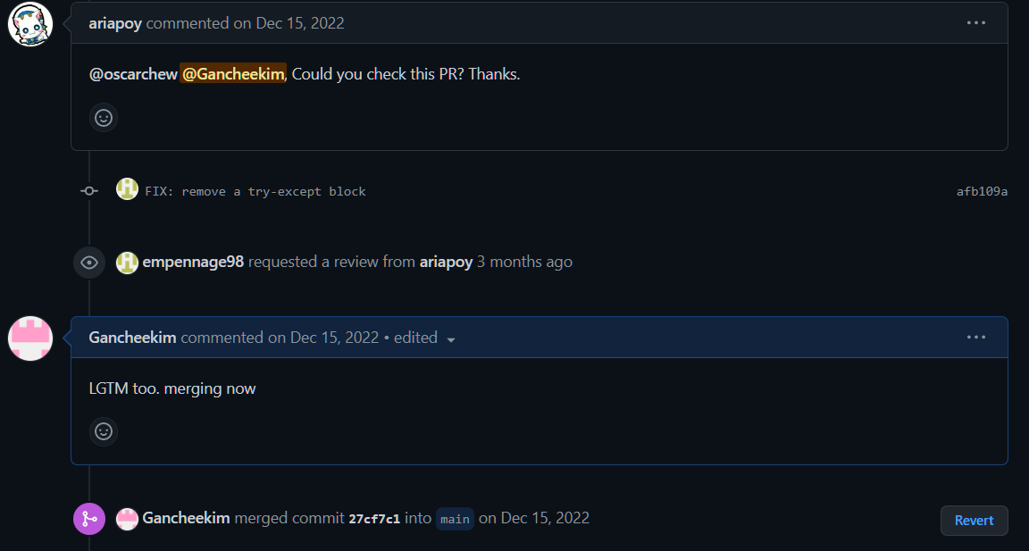
Pull request on github
If the reviewer is busy, assign more reviewer!

Slide 19
Code review
Make sure the code is behaving correctly.
Reviewer MUST fetch the branch and test it before merging.
Use “git fetch <branch_name>” to download the latest version of the remote branch, without actually merging it into your current branch.
Provide specific feedback that is actionable, avoid vague comments!
“your code is messy, please refactor it”: bad approach
“in main.py line 300 function block, please add a Docstring to explain the I/O”: good approach
Be polite.
Use tool to help tracing code.

Slide 20
Some great tools
Git Graph (Vscode extension)
VSCode best git tool (IMO)
Sourcetree
GUI version of git, easy to use
Git Bash
Terminal version for Windows
GitHub CLI
Using CLI terminal to do Pull Request

Slide 21
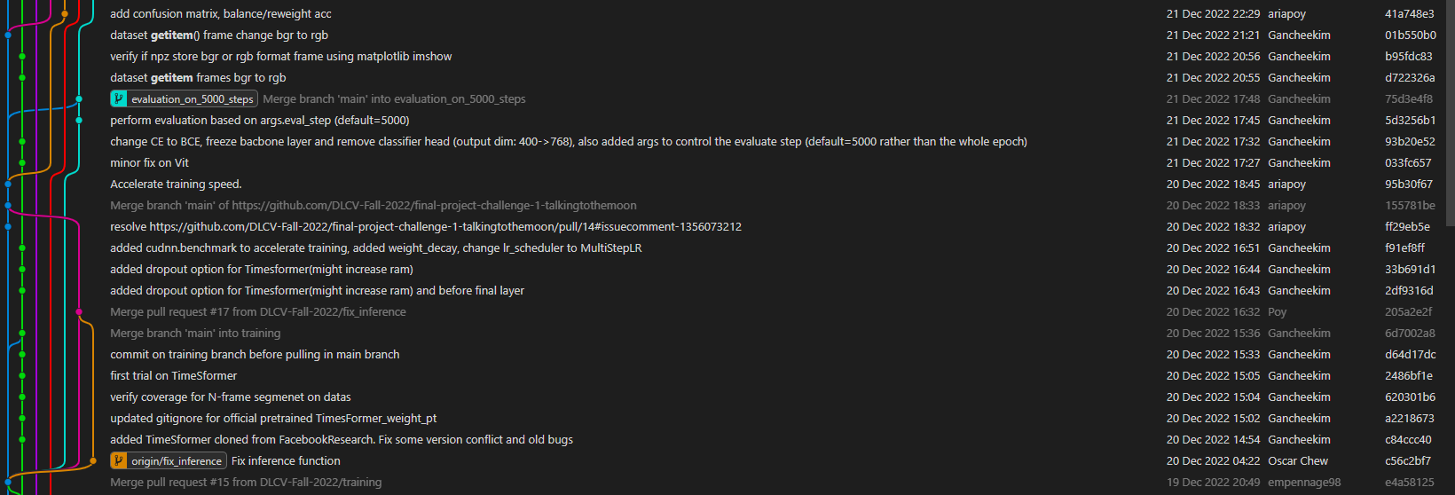
Some great tools
More on Git Graph
Fast overview and synch over your current project’s branches, commit and PR.

Slide 22
Some great tools
More on Git Graph
You can further inspect every changes in each commit, line-by-line:

Slide 23
Tips for writing commit message
Keep it short (less than 20 English words), but also understandable.
Use imperative mood.
Fix bug on xxx feature.
Fixed bug on xxx feature.
If there is too many things to describe, separate your commit message as title and body.
Usage: git commit –m <title> -m <description>
Example: git commit –m “fix bug on Login Access” –m “fix xxx function memory leaked by doing … ” Output: fix bug on Login Access Control fix xxx function memory leaked by doing …

Slide 24
reference
ChatGPT
“About pull requests”, https://docs.github.com/en/pull-requests/collaborating-with-pull-requests/proposing-changes-to-your-work-with-pull-requests/about-pull-requests
“Git Commit Messages: Best Practices & Guidelines” https://initialcommit.com/blog/git-commit-messages-best-practices
“How to Write Better Git Commit Messages” https://www.freecodecamp.org/news/how-to-write-better-git-commit-messages/
Image 1: https://backlog.com/git-tutorial/tw/intro/intro1_1.html
Image 2: https://www.newyorker.com/

Slide 25
Thank you for listening!

